Slide 1
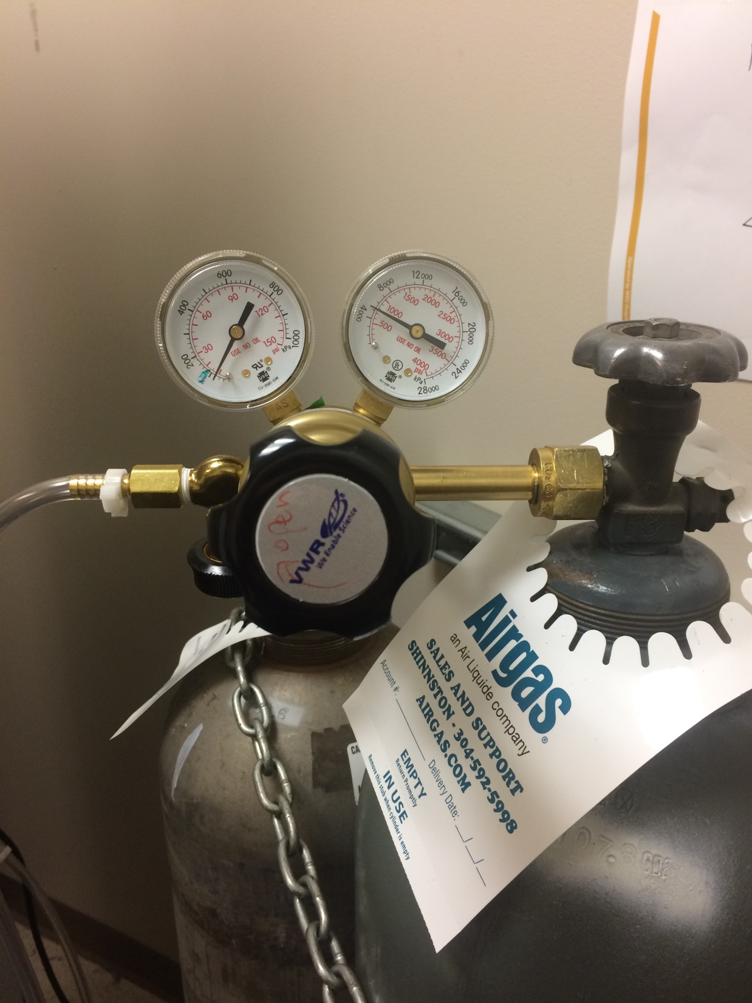
Step 1: close canister valve (valve will say which direction)
Step 3: After making sure both valves are closed and gauges read 0, untighten fitting and transfer gauges to new gas canister
Step 2: close connecter valve (Counterclockwise to close)
Step 4: Open canister valve until you see reading on the right valve. Then you adjust the connecter valve so it’s open but keep it <15psi (left gauge)
Order new canister via marketplace. Select account number 3577871 (under Jianhai Du)

